Slide 1
Assignment 1
Convert CSV to JSON, and Move data from Postgres to MongoDB Using NIFI & Docker

Slide 2
Introduction
Using Nifi & docker, Two examples presented for Nifi templates
Convert Local CSV file to JSON file with simple transformation.
Move data from Postgresql table to MongoDB collection
To clone the repo use the following command
Git clone https://github.com/mohocp/nifi-examples-with-docker.git

Slide 3
Convert CSV to JSON with Transformation

Slide 4
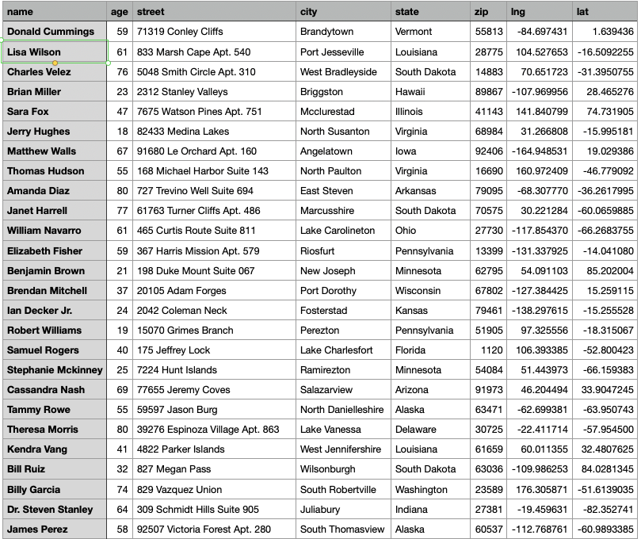
Input Data Shape
The data has 8 fields with different data types
The data available in data directory and named as data.csv
The data generated using Faker using Python

Slide 5
NIFI Workflow Processes
The following processes used to achieve the task
GetFile Process used to get file from the data directory
SplitRecord used to separate each record to spearted FileFlow
CSVReader service used for parsing the incoming data.
CSVRecordSetWrite service used for writing the result to FileFlow
QueryRecord allow to filter the set of FileFlows based on age > 40 condition
ExtractText used to store the content of the fields in Attributes

Slide 6
NIFI Workflow Processes (Cont.)
ReplaceText used to replace the content of FileFlow with JSON using nifi expression language to get the value of attributes
MergeContent used to merge all FileFlows items in one FileFlow
UpdateAttribute used to update the file with uuid + date of today + json
PutFile used to load the final JSON file in output directory
LogAttribute two processes was added; the first one used to handle the unhappy and unwanted relationships i.e. (failure, origin, unmatched) and the other one used to debug on the last step

Slide 7
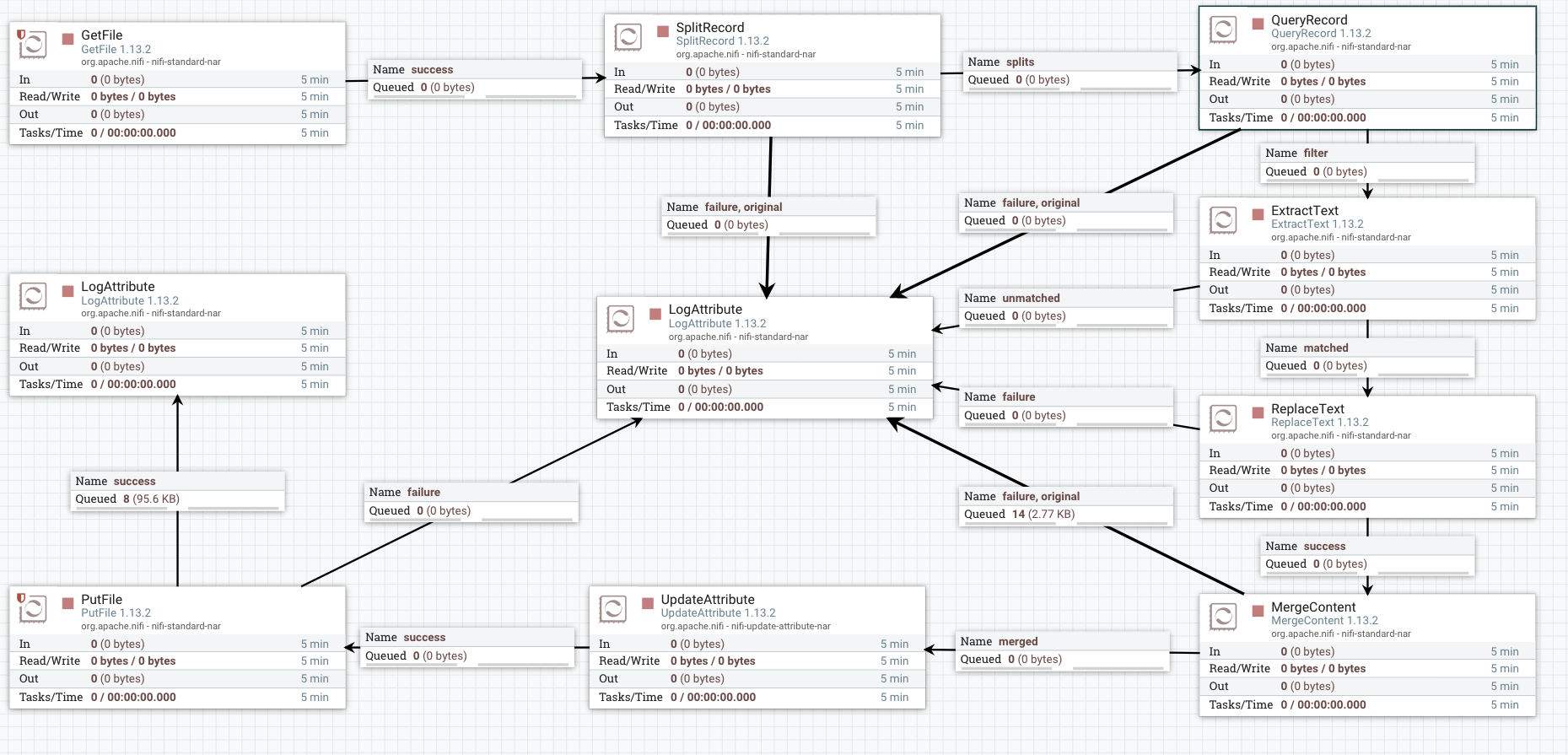
NIFI Workflow Processes (Cont.)
The screenshot below demonstrate the workflow

Slide 8
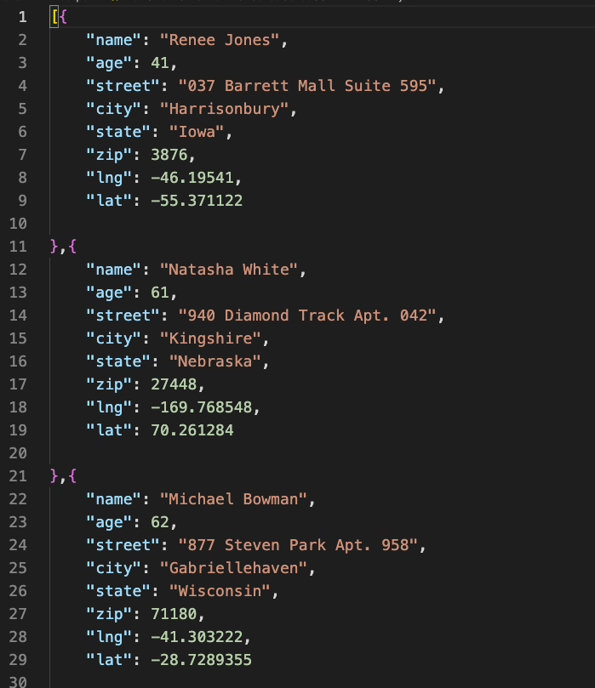
Output
The Output will be as JSON file in the output directory

Slide 9
Move data from Postgresql table to MongoDB collection

Slide 10
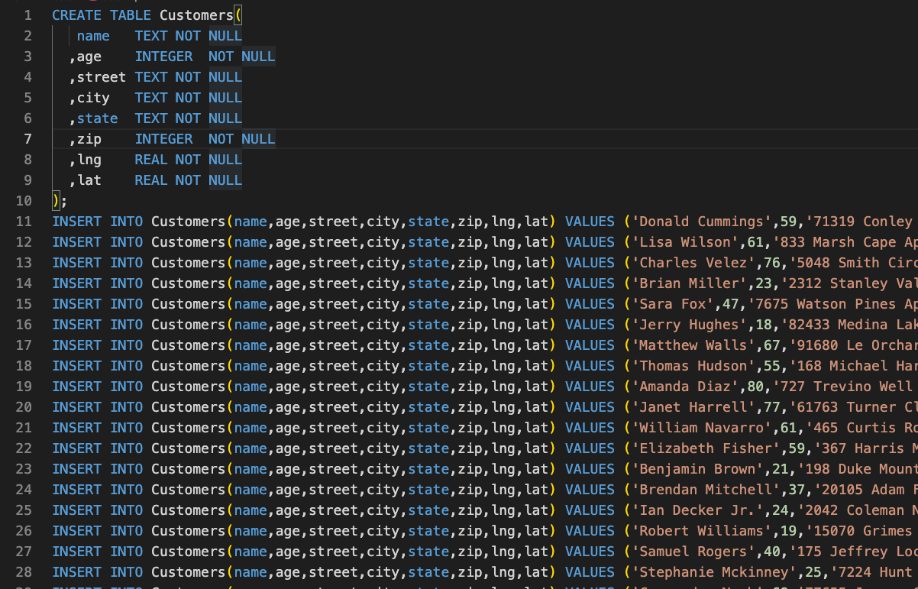
Input Data Shape
Data.sql file available in data directory
The file need to be executed using PGAdmin to create the table and insert data to Postgresql
The data generated using Faker using Python

Slide 11
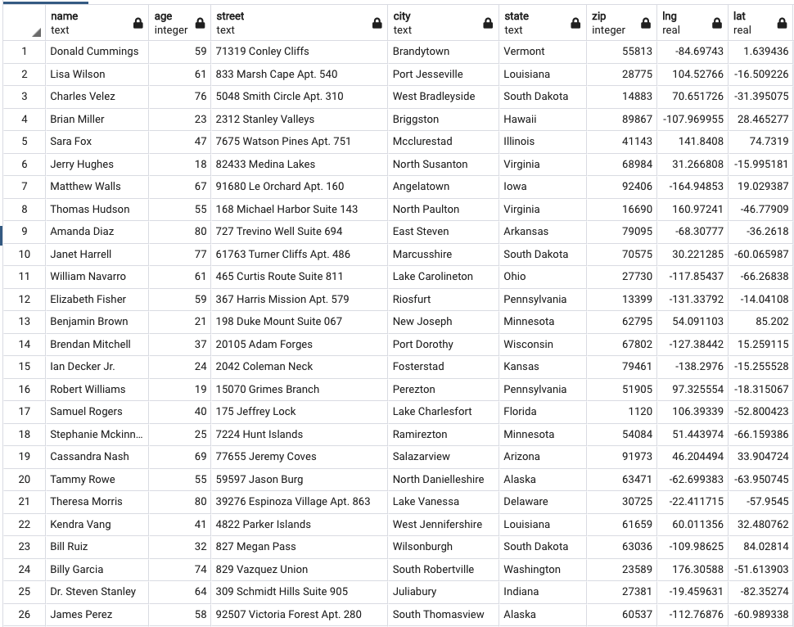
Data Shape In Posgresql
The result of execute the data.sql script using PGAdmin

Slide 12
NIFI Workflow Processes (Cont.)
ExtractText used to store the content of the fields in Attributes
ReplaceText used to replace the content of FileFlow with JSON using nifi expression language to get the value of attributes
PutMongo used to load the JSON records to MongoDB
LogAttribute two processed was added; the first one used to handle the unhappy and unwanted relationships i.e. (failure, origin, unmatched) and the other one used to debug on the last step

Slide 13
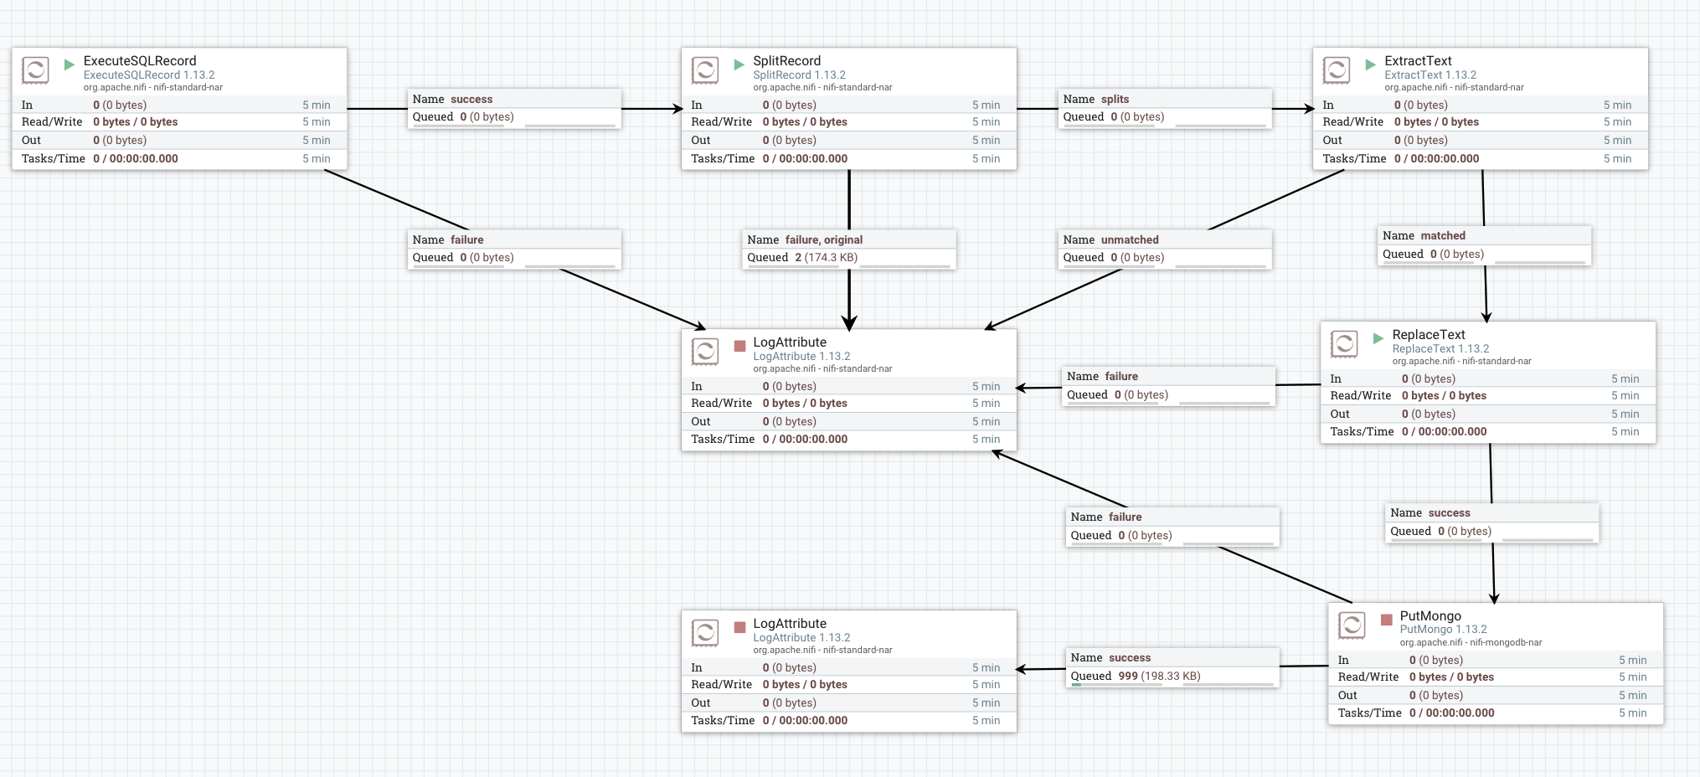
NIFI Workflow Processes (Cont.)
The screenshot below demonstrate the workflow

Slide 14
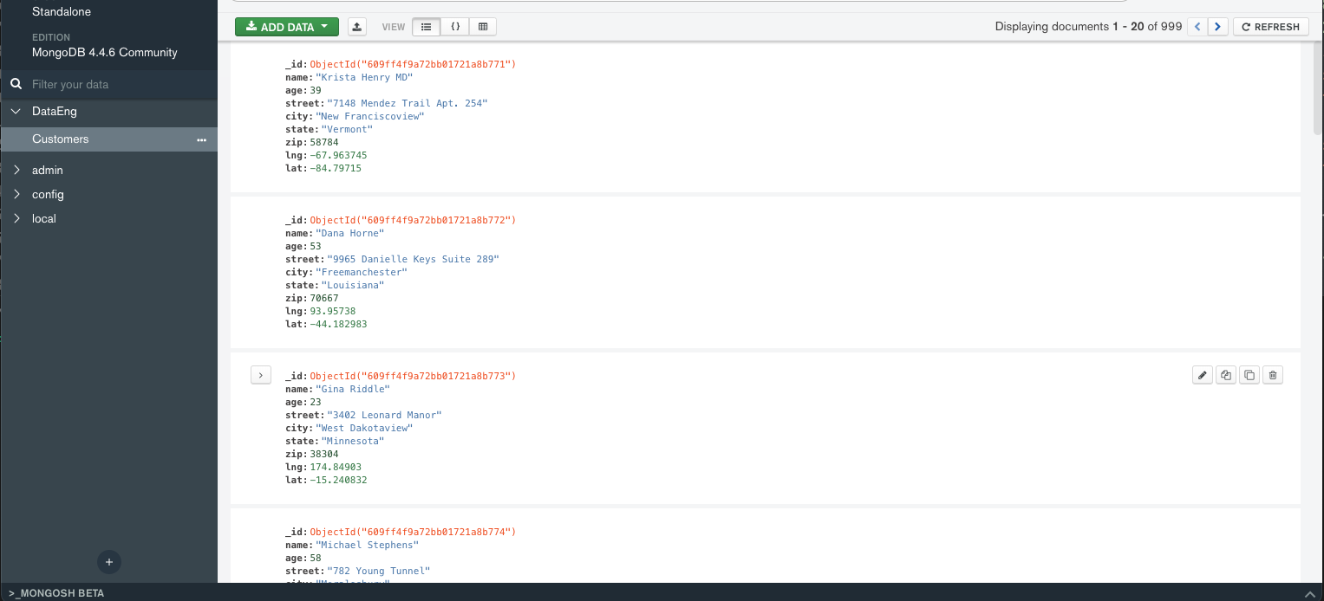
Output
The data after inserted to MongoDB collection

